Slide 1
Creating Tools for Semantic Space Visualization
The Doom Lab
Erin M. Buchanan, Ari Cunningham, Amber Gillenwaters, Will Padfield, Abbie Van Nuland, Addie Wikowsky

Slide 2
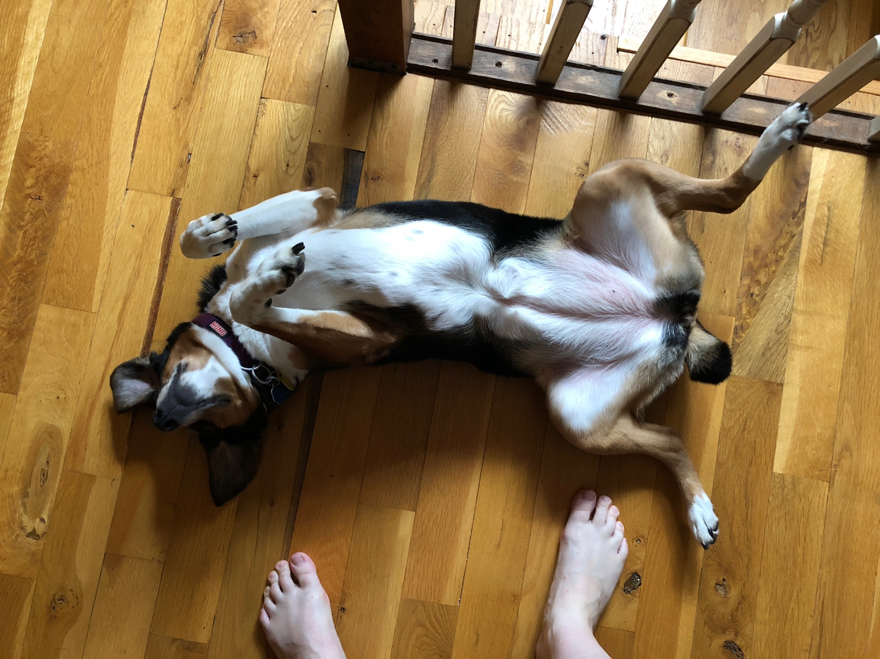
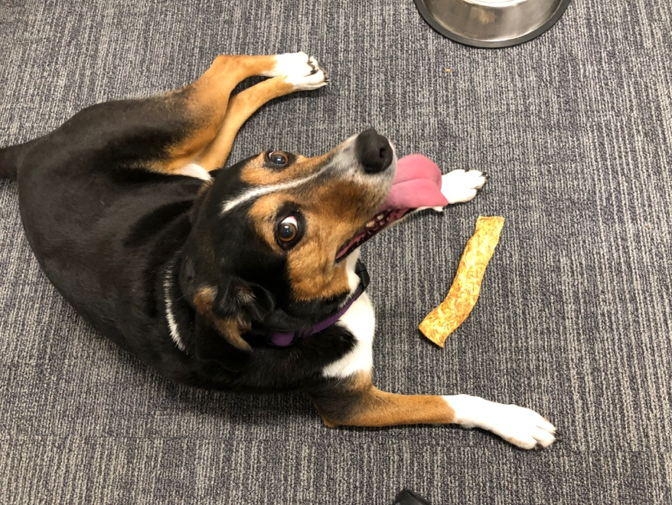
A SCiP story

Slide 3
Bridging the Gap
Semantic spaces – representations of language, capturing the meaning between linguistic units
Often requires specialized skill sets including coding

Slide 4

What is shiny?
Shiny is an R package that allows you to code interactive web applications for others to use.
Naïve users can explore data without understanding programming.
The app was designed as a teaching extension for psycholinguistic courses.

Slide 5
Using the App
Use the app
https://doomlab.shinyapps.io/wordspace/
Download the code
https://github.com/doomlab/shiny-server/tree/master/scip_wordspace

Slide 6
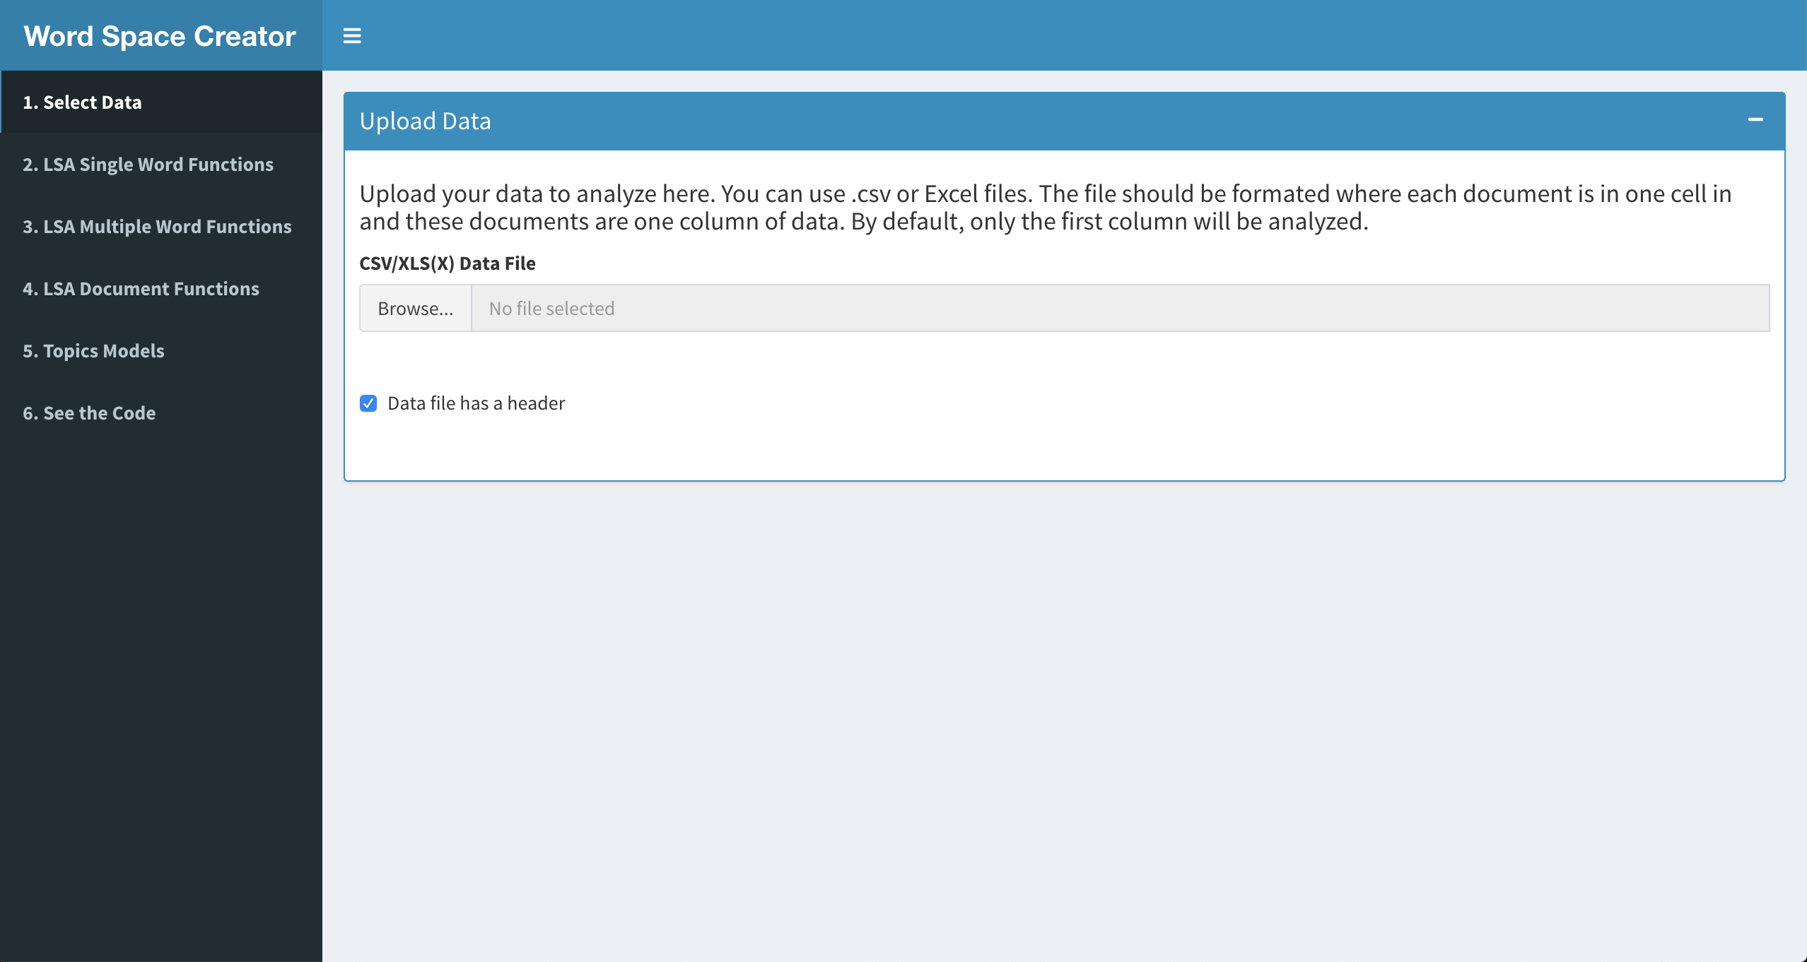
Using the App

Slide 7
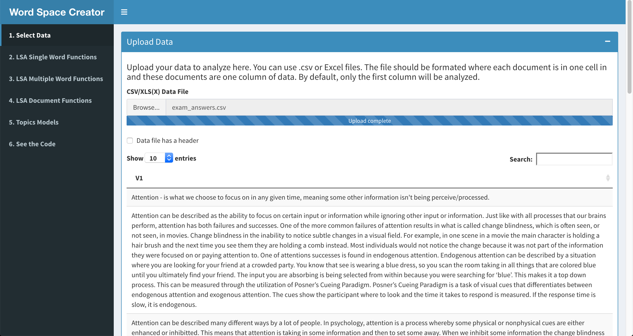

Slide 8
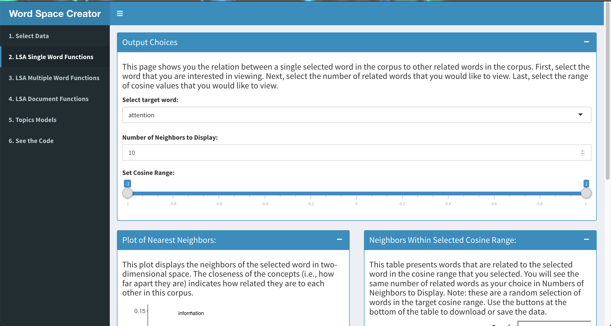

Slide 9
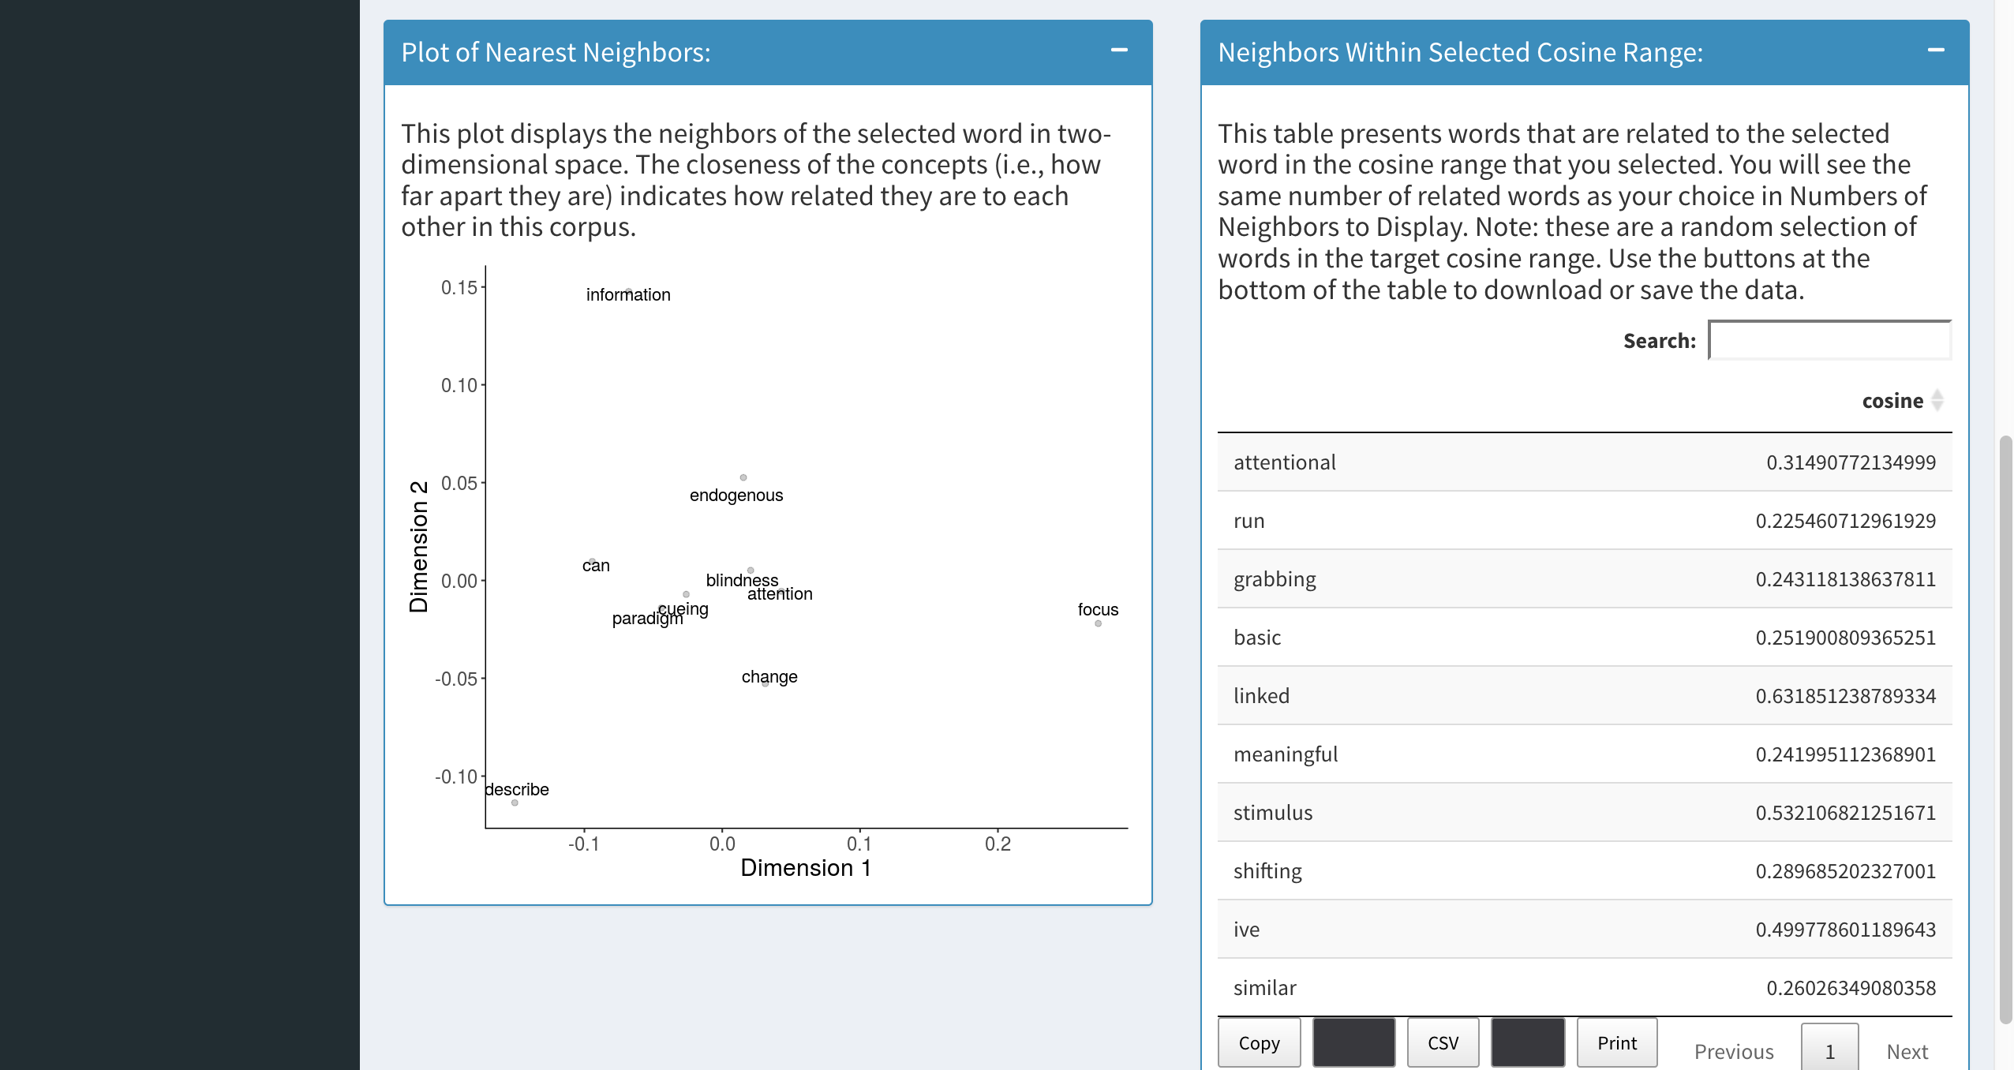

Slide 10
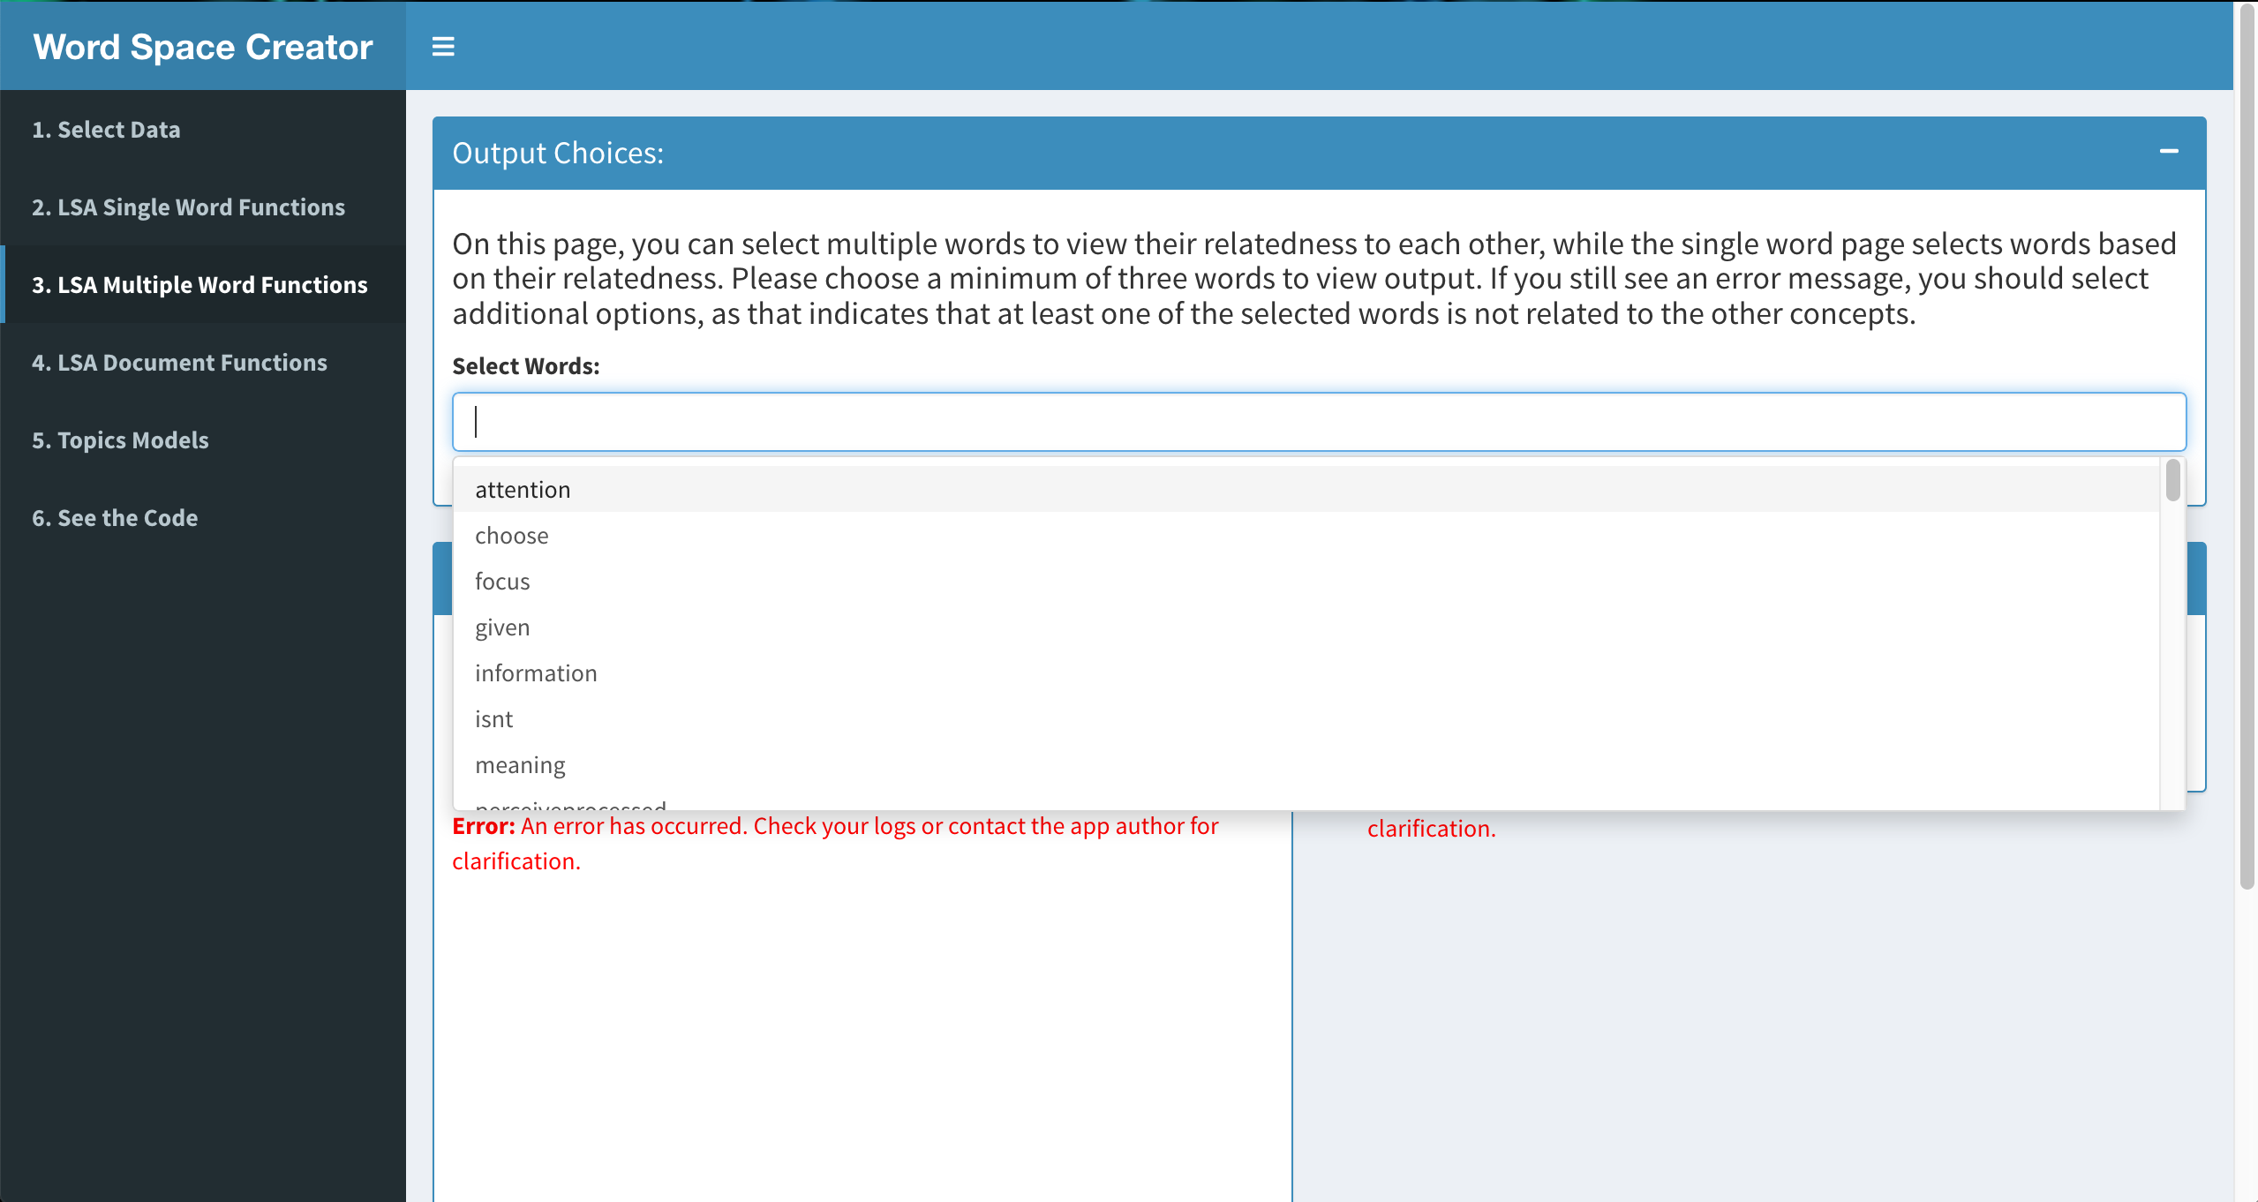

Slide 11
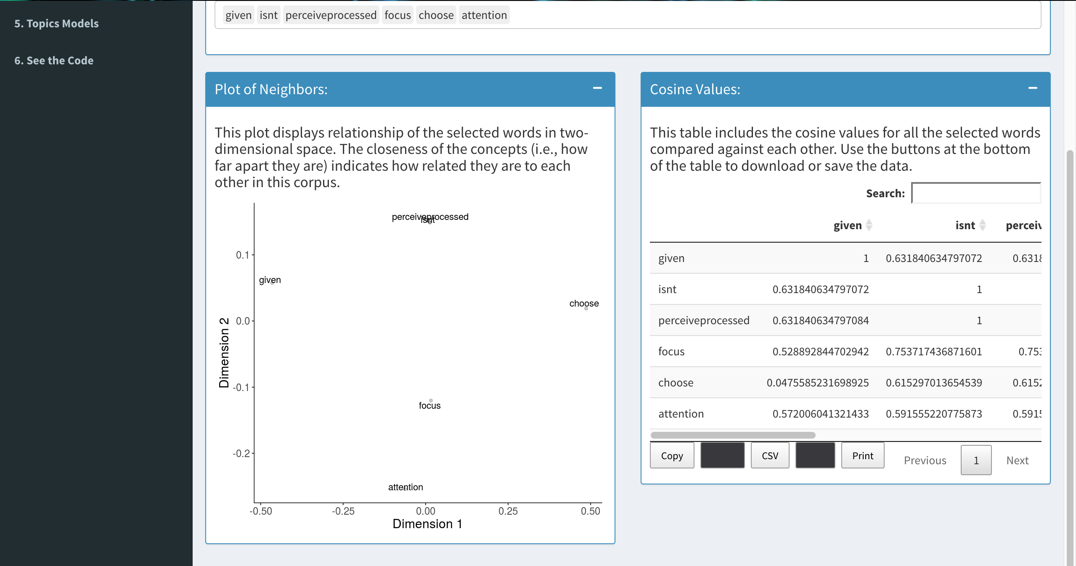

Slide 12
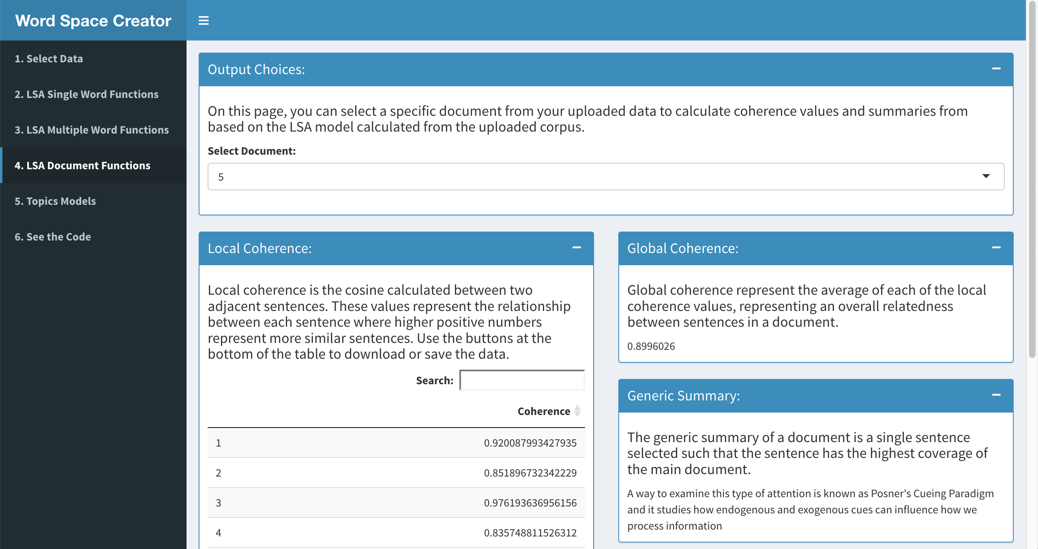

Slide 13
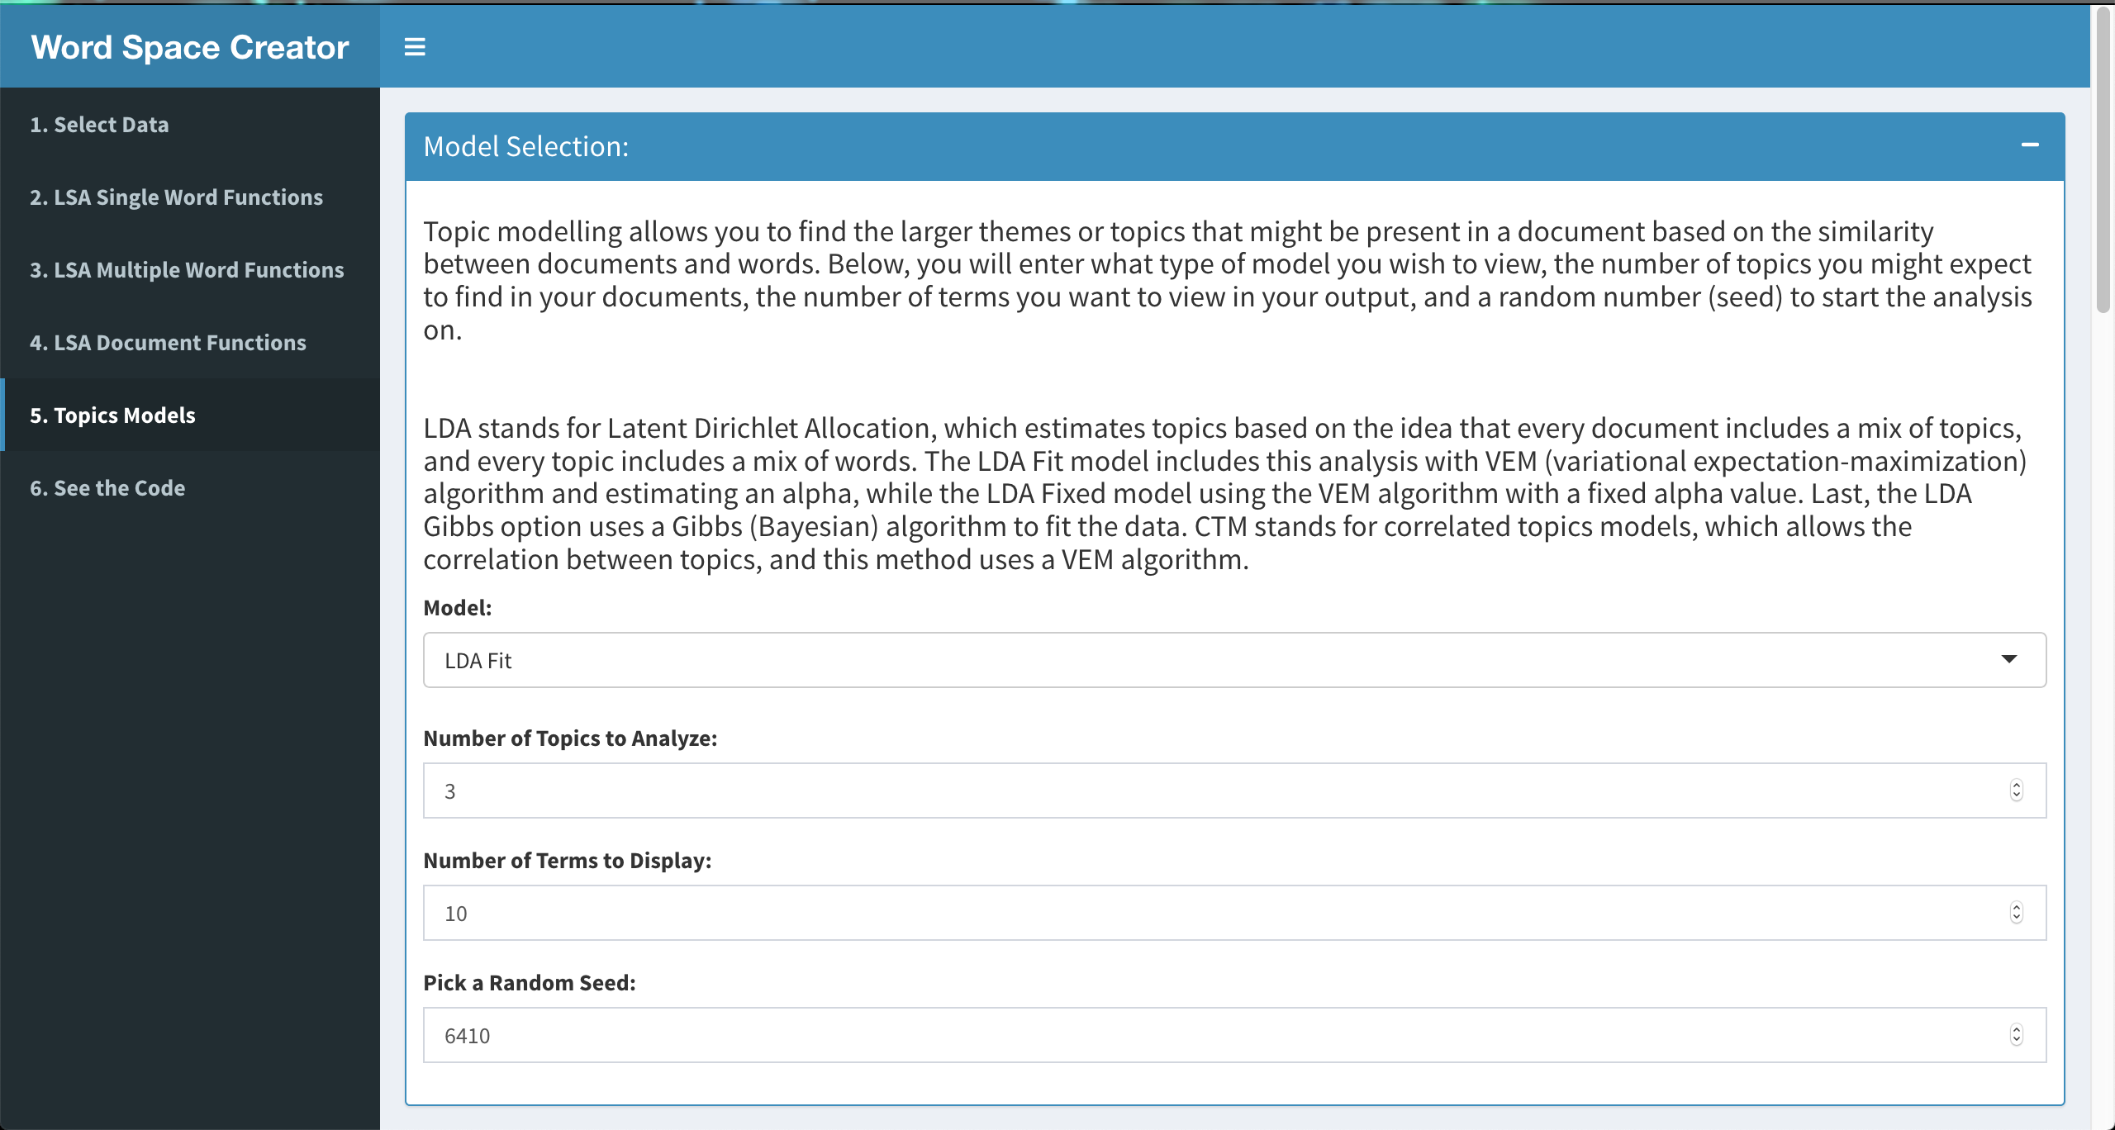

Slide 14
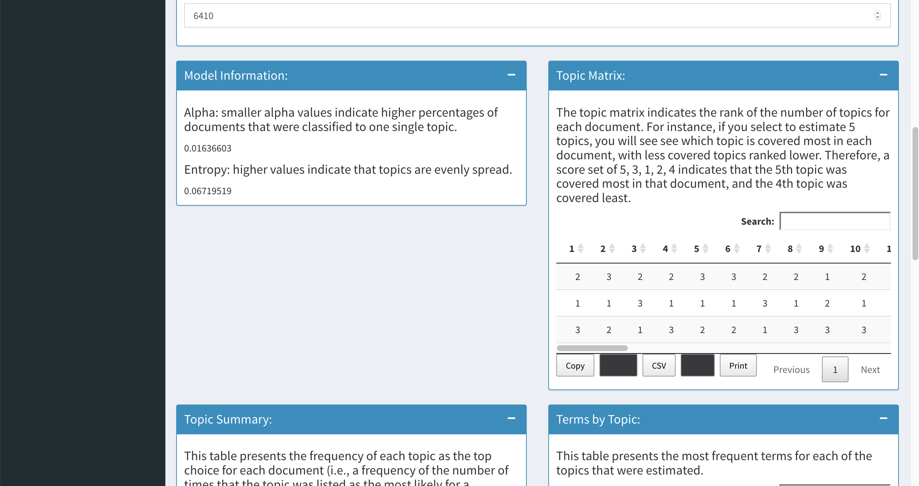

Slide 15
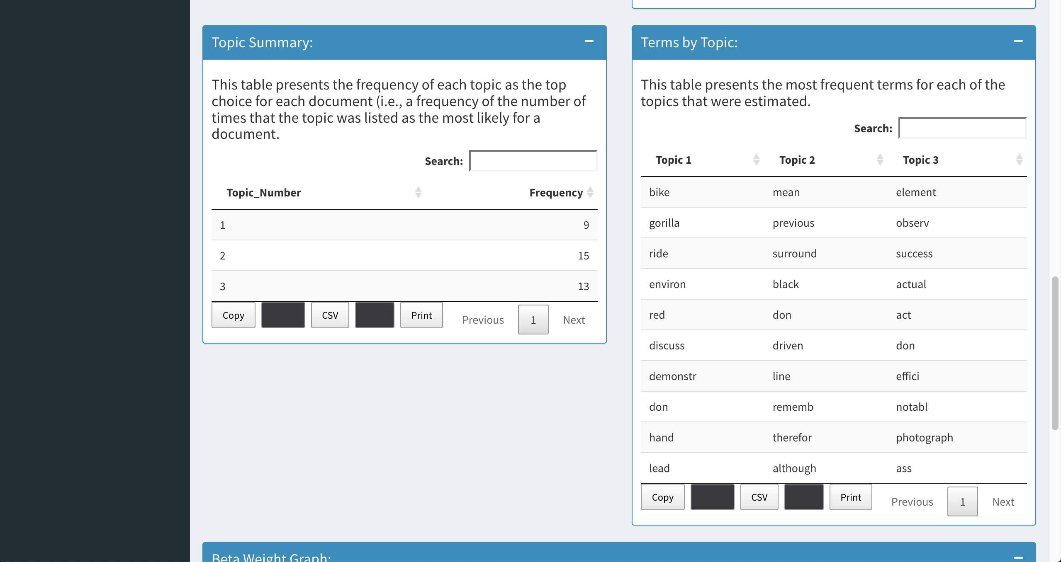

Slide 16
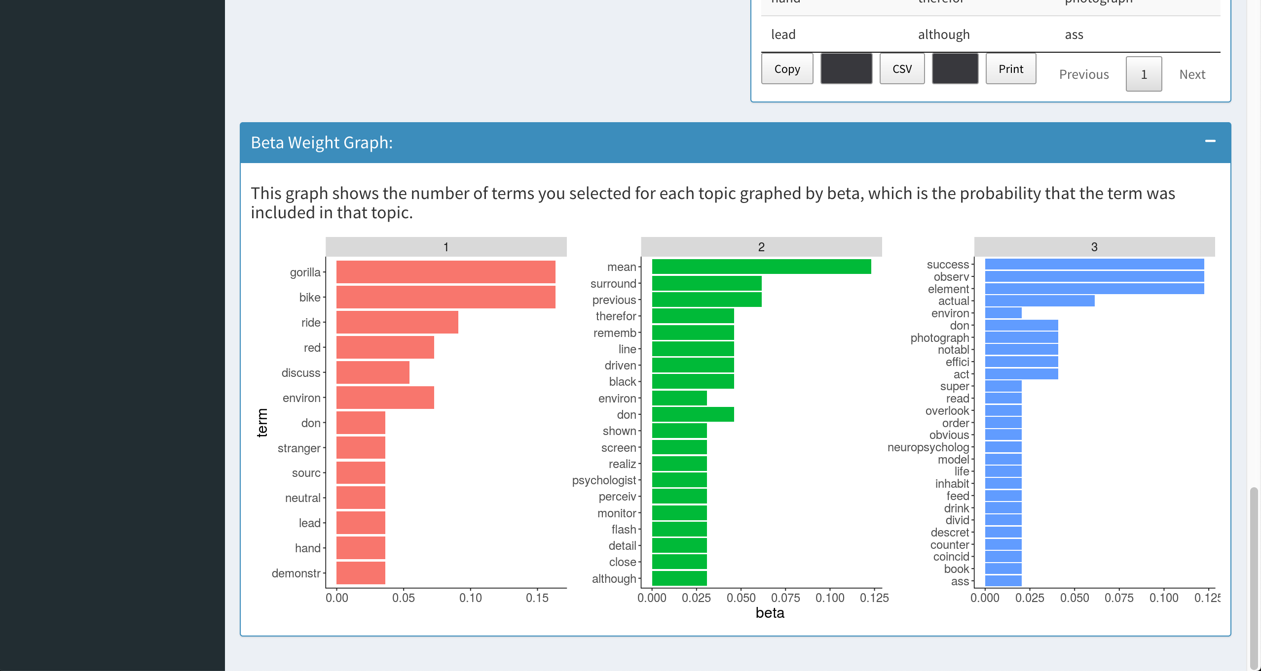

Slide 17
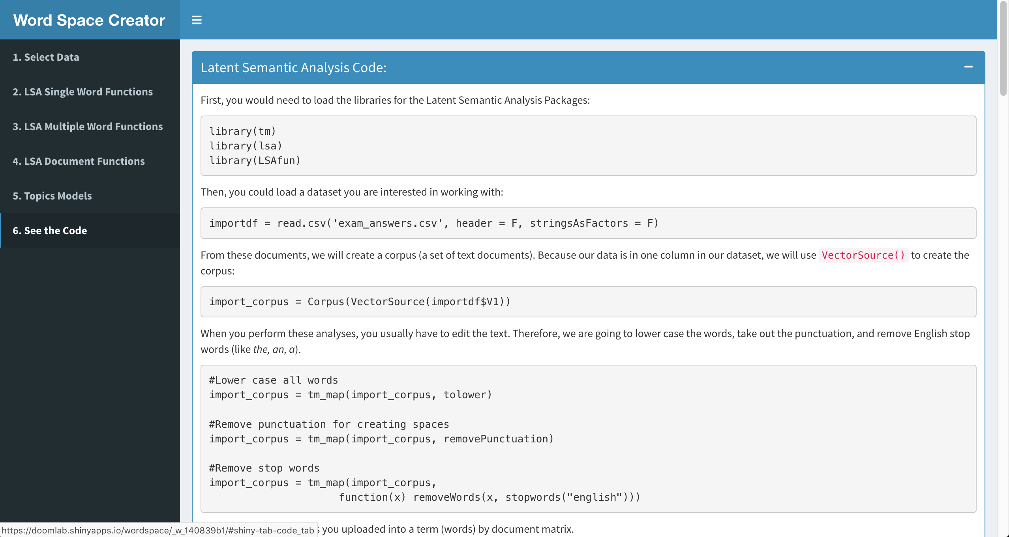

Slide 18
Final Thoughts
Goals would be to add other word space model techniques
Expanding teaching and research opportunities
Thanks to the team who helped design and create the app.
Questions?

